Slide 1
SQL ASSIGNMENT
ON
ATHELETE DATA OF OLYMPICS
RITESH SINGH

Slide 2

1. Showing medals count for entire data
SELECT
COUNT(CASE WHEN Medal = 'Gold' THEN 1 END) AS Gold_Medals,
COUNT(CASE WHEN Medal = 'Silver' THEN 1 END) AS Silver_Medals,
COUNT(CASE WHEN Medal = 'Bronze' THEN 1 END) AS Bronze_Medals,
COUNT(Medal) AS Total_Medals
FROM athletes;

Slide 3


2. count of unique Sports presents in olympics
SELECT COUNT(DISTINCT Sport) AS Unique_Sports_Count
FROM athletes;
3. Different medals won by Team India
SELECT
COUNT(CASE WHEN Medal = 'Gold' THEN 1 END) AS Gold_Medals,
COUNT(CASE WHEN Medal = 'Silver' THEN 1 END) AS Silver_Medals,
COUNT(CASE WHEN Medal = 'Bronze' THEN 1 END) AS Bronze_Medals,
COUNT(Medal) AS Total_Medals
FROM athletes
WHERE Team = 'India';

Slide 4
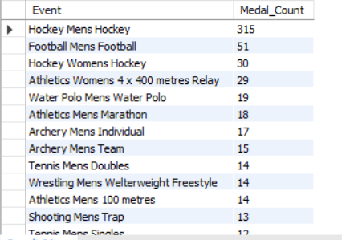
4. Event wise medals won by india show from highest to lowest medals won in order
SELECT
Event,
COUNT(Medal) AS Medal_Count
FROM athletes
WHERE Team = 'India'
GROUP BY Event
ORDER BY Medal_Count DESC;

Slide 5
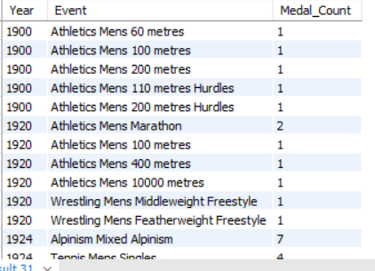
5. Event and yearwise medals won by india in order of year
SELECT
Year,
Event,
COUNT(Medal) AS Medal_Count
FROM athletes
WHERE Team = 'India'
GROUP BY Year, Event
ORDER BY Year, Medal_Count DESC;

Slide 6

6. The country with maximum medals won gold, silver, bronze
SELECT
Team,
COUNT(CASE WHEN Medal = 'Gold' THEN 1 END) AS Gold_Medals,
COUNT(CASE WHEN Medal = 'Silver' THEN 1 END) AS Silver_Medals,
COUNT(CASE WHEN Medal = 'Bronze' THEN 1 END) AS Bronze_Medals,
COUNT(Medal) AS Total_Medals
FROM athletes
GROUP BY Team
ORDER BY Total_Medals DESC
LIMIT 1;

Slide 7
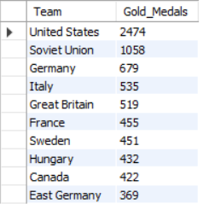
7. The top 10 countries with respect to gold medal
SELECT
Team, COUNT(*) as Gold_Medals
FROM athletes
WHERE Medal = 'Gold'
GROUP BY Team
ORDER BY Gold_Medals DESC
LIMIT 10;

Slide 8

8. year which United States won most of the medals
SELECT
Year, COUNT(*) as Total_Medals
FROM athletes
WHERE Team = 'United States'
GROUP BY Year
ORDER BY Total_Medals DESC
LIMIT 1;

Slide 9

9. United States medals in different sports
SELECT
Sport, COUNT(*) as Total_Medals
FROM athletes
WHERE Team = 'United States'
GROUP BY Sport
ORDER BY Total_Medals DESC
LIMIT 1;

Slide 10

10. Top 3 players who have won most medals along with their sports and country
SELECT
Name,
Sport,
Team,
COUNT(Medal) AS total_medals
FROM
athletes
WHERE
Medal IS NOT NULL
GROUP BY
Name, Sport, Team
ORDER BY
total_medals DESC
LIMIT 3;

Slide 11

11. player with most gold medals in cycling along with his country
SELECT
Name,
Team,
COUNT(Medal) AS gold_medals
FROM
athletes
WHERE
Sport = 'Cycling'
AND Medal = 'Gold'
GROUP BY
Name, Team
ORDER BY
gold_medals DESC
LIMIT 1;

Slide 12

12. player with most medals (Gold + Silver + Bronze) in Basketball along with country
SELECT
Name,
Team,
COUNT(Medal) AS total_medals
FROM
athletes
WHERE
Sport = 'Basketball'
AND Medal IN ('Gold', 'Silver', 'Bronze')
GROUP BY
Name, Team
ORDER BY
total_medals DESC
LIMIT 1;

Slide 13

13. the count of different medals of the top basketball player
WITH TopPlayer AS (
SELECT Name, Team
FROM athletes
WHERE Sport = 'Basketball' AND Medal IS NOT NULL
GROUP BY Name, Team
ORDER BY COUNT(Medal) DESC
LIMIT 1
)
SELECT
Medal,
COUNT(*) AS medal_count
FROM
athletes
JOIN
TopPlayer ON athletes.Name = TopPlayer.Name AND athletes.Team = TopPlayer.Team
WHERE
Sport = 'Basketball' AND Medal IS NOT NULL
GROUP BY
Medal;

Slide 14
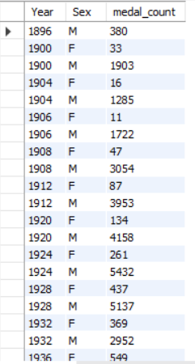
14. medals won by male, female each year.
SELECT
Year,
Sex,
COUNT(Medal) AS medal_count
FROM
athletes
WHERE
Medal IS NOT NULL
GROUP BY
Year, Sex
ORDER BY
Year, Sex;

